Slide 1


DESCRIPTIVE ANALYSIS OF THE PERSONAL LOAN MODELING DATASET
GROUP 2

Slide 2

MEMBERS-GROUP 2
K.A.I. Kandewatte-s13994
S.H. Karunadhika- s13995
B.D.S. Suwaris –s14024

Slide 3
Content….
Introduction to the Question
About the Dataset
Methodology
Explanatory Analysis
Suggestions for advanced Analysis

Slide 4




1.An introduction to the question…..
The personal loan market is exploding..…
There is a rising role of marketing in the banking sector and it the function which gets personality and image for bank on its customers’ mind. Data can be considered as an asset in the process of marketing. By utilizing such data, marketing department of the Thera Bank can begin to build better marketing campaigns in addition to creating stronger product offerings.
THERA
To predict whether a customer will accept Personal Loan or not

Slide 5



Objectives
To construct a suitable model to predict whether a customer will accept the Personal Loan offer based on customer demographic information and the customer’s relationship with the bank.
To identify the potential clients for loans by minimizing loss of resources and opportunities.

Slide 6


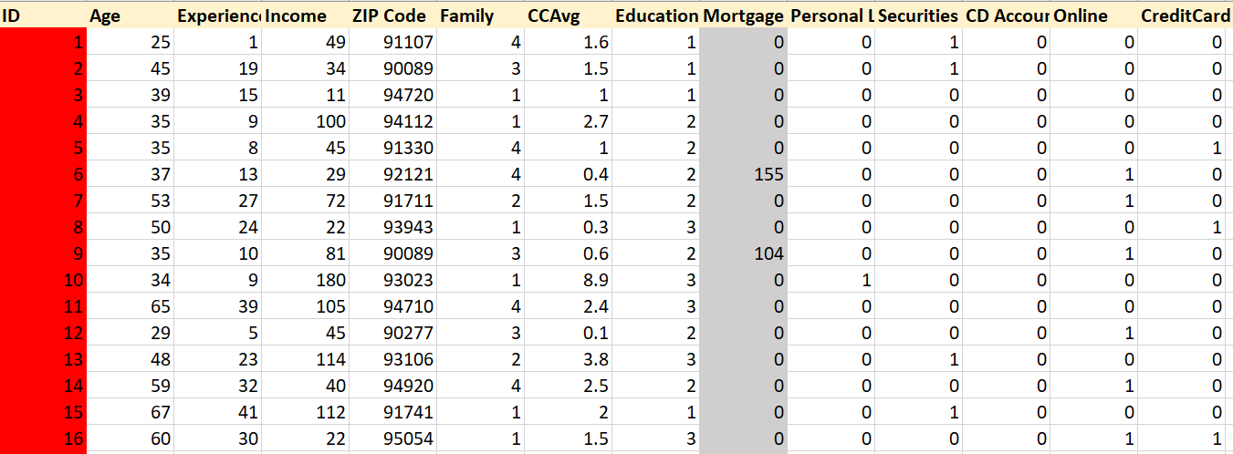
2.About the dataset
The dataset contains observations from 5000 customers and 14 variables.
The data include customer demographic information (age, income, etc.), the customer's relationship with the bank (mortgage, securities account, etc.), and the customer response to the last personal loan campaign (Personal Loan).

Slide 7

Variables
No. | Variable | Description
1 | ID | Customer ID
2 | Age | Customer's age in completed years
3 | Experience | Number of years of professional experience
4 | Income | Annual income of the customer ($000)
5 | ZIP Code | Home Address ZIP code.
6 | Family | Family size of the customer
7 | CCAvg | Avg. spending on credit cards per month ($000)
8 | Education | Education Level. 1: Undergrad; 2: Graduate; 3: Advanced/Professional
9 | Mortgage | Value of house mortgage if any. ($000)
10 | Personal Loan | Did this customer accept the personal loan offered in the last campaign?
11 | Securities Account | Does the customer have a securities account with the bank?
12 | CD Account | Does the customer have a certificate of deposit (CD) account with the bank?
13 | Online | Does the customer use internet banking facilities?
14 | CreditCard | Does the customer use a credit card issued by this Bank?

Slide 8

3. Methodology
Data Cleaning
Splitting the dataset into training and testing
Performing descriptive analysis on the training dataset
Obtaining suggestions for advanced analysis
Finding the best possible model to do the prediction

Slide 9
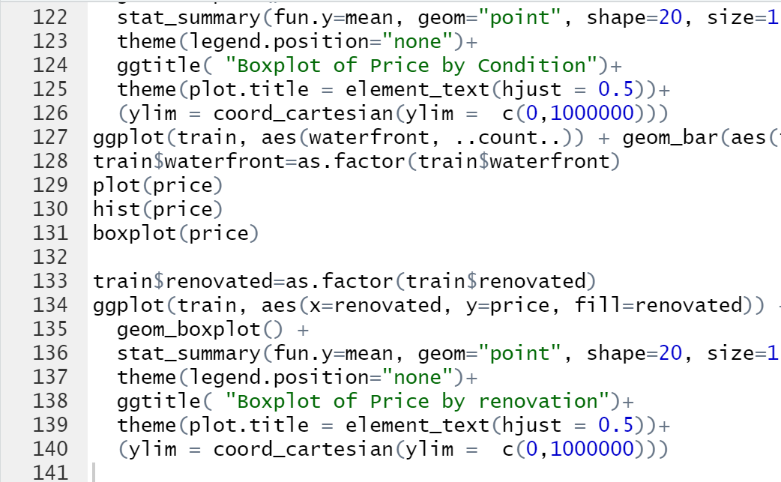
Data Cleaning
Variables Removed
ID
Re-created variables
Changed Variable Type
Years of experience had negative values
Absolute values were taken
Family
Education
Securities Account
CD Account
Zip Code
Online
CreditCard
Personal Loan
Converted to “category” type

Slide 10



4.EXPLANATORY ANALYSIS

Slide 11

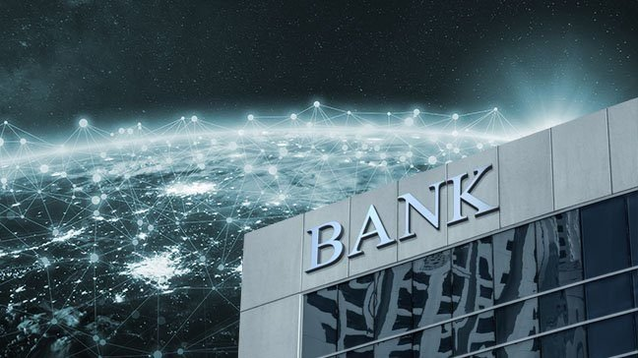
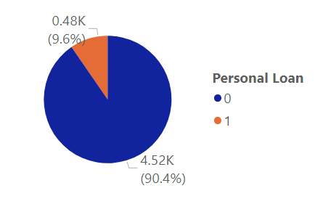
Personal Loan
“Market segmentation makes it easier for marketing teams to develop highly targeted and effective marketing campaigns and plans.
They gain a better understanding of customer’s needs and wants and therefore can tailor campaigns to customer segments most likely to purchase products.”
-IMS Marketing-
! Imbalanced
The conversion rate of the personal loan marketing campaign is 9.6%.

Slide 12

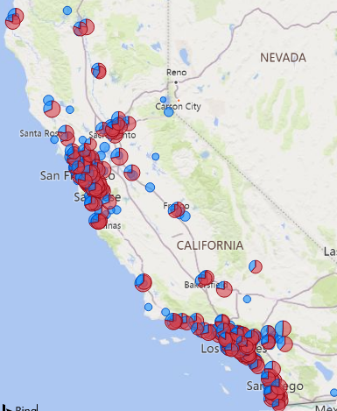
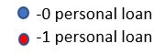
Location
Average income is very low in some parts of the country where none of the customers have obtained a personal loan.
Average income of the cities where customers have accepted the loans is very high comparatively to the other cities.
13.0% of South Lake Tahoe, CA residents had an income below the poverty level in 2019, which was 9.9%.
-city-data site of USA-

Slide 13


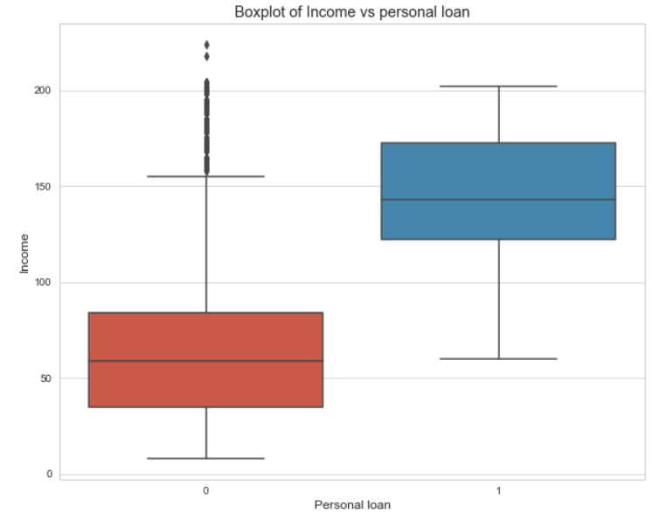
Income
Lenders impose income requirements on borrowers to ensure they have the means to repay a new loan.
The SoFi finance company in USA imposes a minimum salary requirement of $45,000 per year.
-Forbes Advisor journal-
The median annual income of customers who have applied for personal loans is higher than that of customers who haven’t applied for personal loans!!!

Slide 14

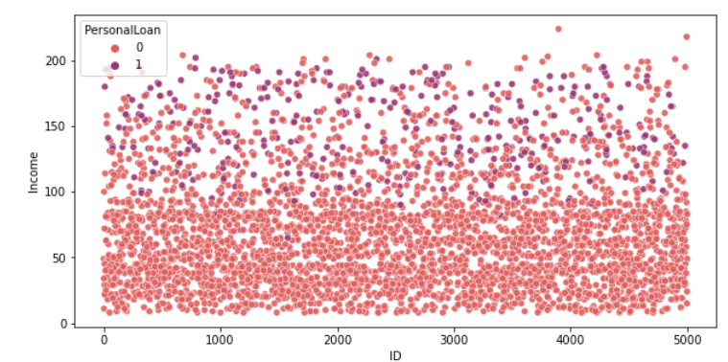
Americans with annual income over $100,000 are more likely to consider taking out a personal loan than those with lower incomes.
- Ascent personal loan statistics-
Minimum income requirement of Thera Bank is approximately
$100,000 per year
Targeting the wrong market (i.e. customers with low income) will cost a lot for the marketing department.

Slide 15


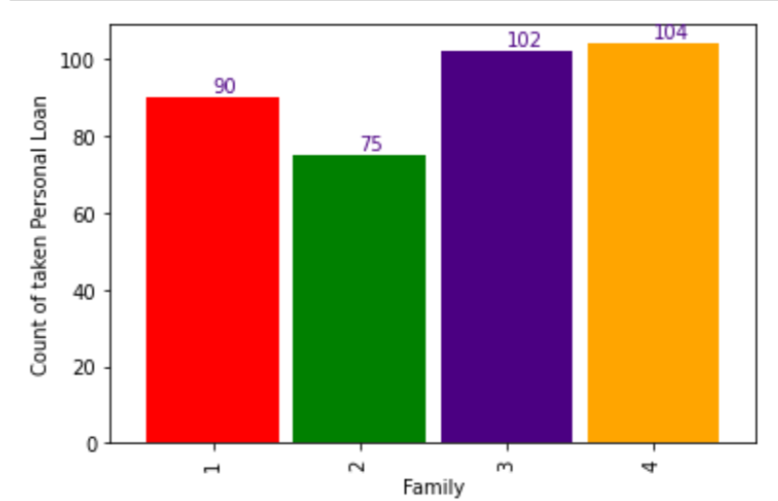
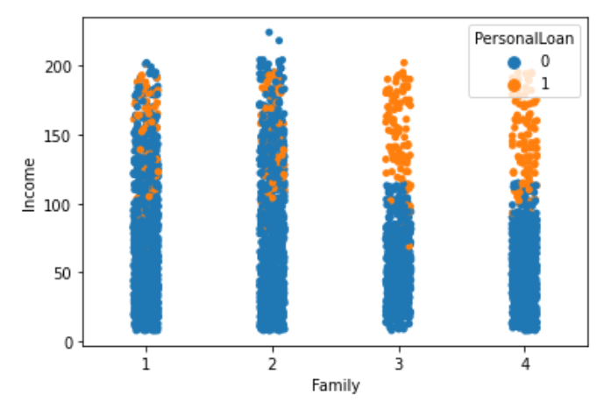
Family size
Only the higher income families out of the families of larger sizes have obtained a personal loan. The minimum income requirements imposed when obtaining loan personal loans may be the possible reason for this.
Larger families feel the need to get personal loans more!
WHY?

Slide 16


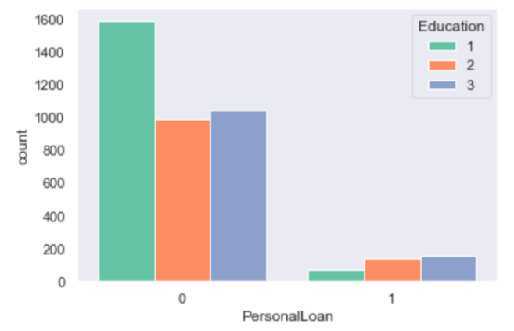
Education
The customers with Advanced/professional education (3) have accepted the personal loan more than the undergraduates (1) and graduates (2)
Undergraduates, they may not find it necessary to buy a personal loan to fund their education due to the scholarship offers.
The undergraduates do not have a proper source of income to repay the loans.
Higher the education level the more the customer is confident and open to opt for personal loans.
Why?

Slide 17


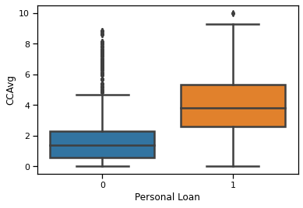
Credit Card Spending
Customers with high average spending on Credit Card per month have decided to get a Personal Loan offered in the last campaign.
“The credit cards have the highest interest rates out of every kind of credit product”
Megan DeMatteo
an editor at Business Insider
The vast majority of borrowers in USA are using personal loans to consolidate debt and refinance credit cards, combining for a total of 61% for all personal loans.
-Research:LendingTree-

Slide 18

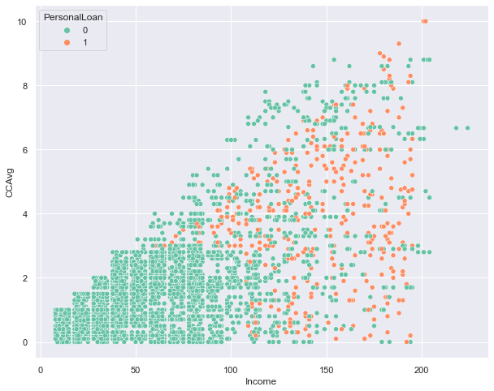
Customers with a higher income have a higher average spending on credit card

Slide 19

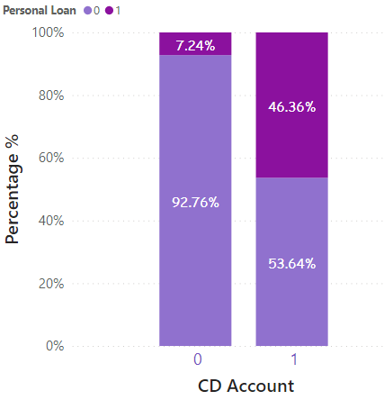
Certificate of Deposit Account
“There are two types of personal loans namely secured and unsecured.”
Jennifer Brozic
A significant percentage , 46.36% of customers who have CD accounts have accepted a personal loan after the last campaign.
CD accounts restrict access to money, customers tend to buy personal loans to satisfy their monetary requirements.

Slide 20

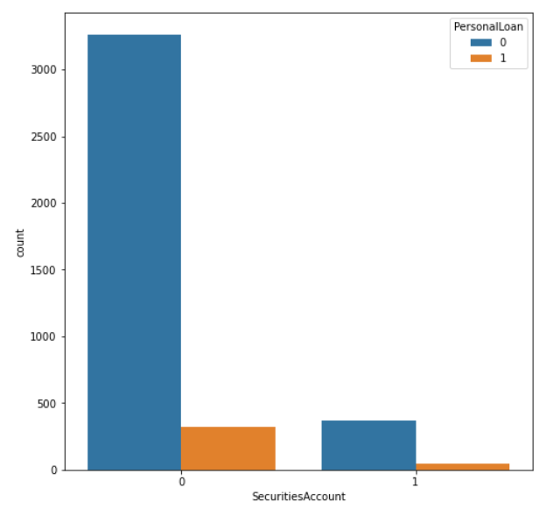
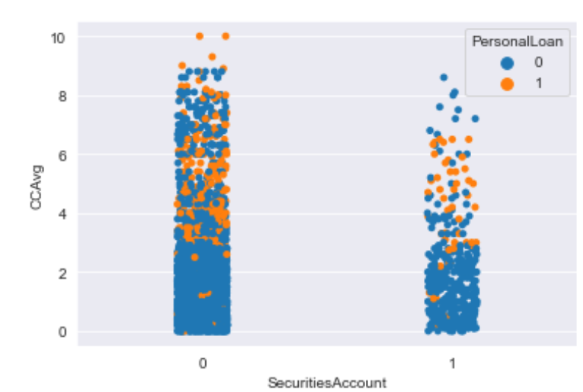
Securities Account
Most of the customers who have accepted the personal loan do not have a securities account since the risks involving security account demotivate to accept personal loans.
The average credit card spending per month is low among customers who have a securities account than the other group.
WHY?
The security account holders may be less motivated to spend on credit cards since they already have many risks involved with the securities account as explained earlier.

Slide 21


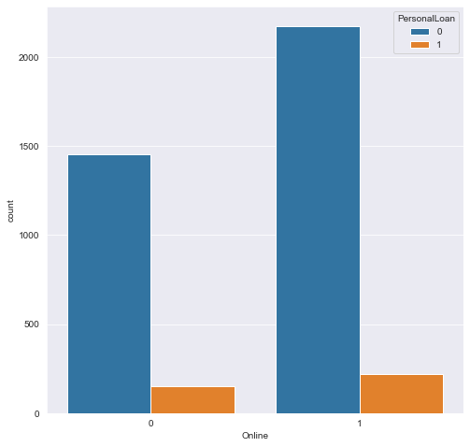
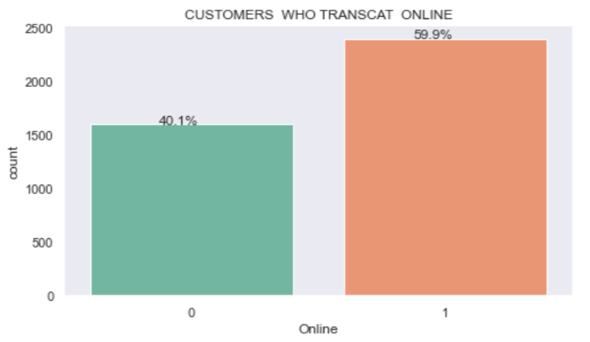
Online
Approximately 60% of the customers transact online. According to the author Jamie Gonzalez-Garcia, in 2016, 62% of Americans cited digital banking as their primary method of banking.
Greater number of online users have obtained the personal loan than the non-online users. By making use of online platforms to market the personal loans will attract more customers which in result would give a healthy conversion rate.

Slide 22

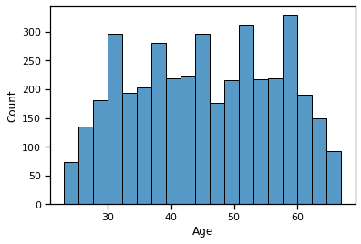
Age
Mean | Min | 25% | Median | 75% | Max
45.446750 | 23.0 | 36.0 | 46.0 | 55.0 | 67.0
In USA most lenders require applicants to provide at least two forms of government-issued identification to prove they are at least 18 years old.
- Forbes advisor magazine-
Since all the customers of the Thera Bank are above 23 years, any customer will be eligible for a loan based on their age
WHY?
Most of the customers fall into 36 to 55 years of age

Slide 23

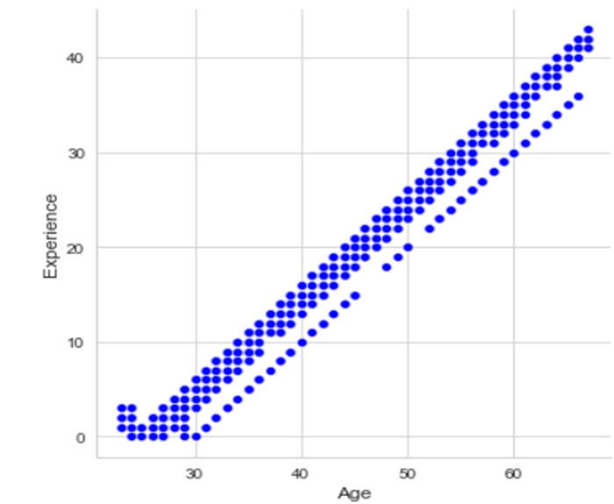
There is a very strong positive relationship between experience and age!!!!
An "aged" person can be said to have lot of experience.

Slide 24


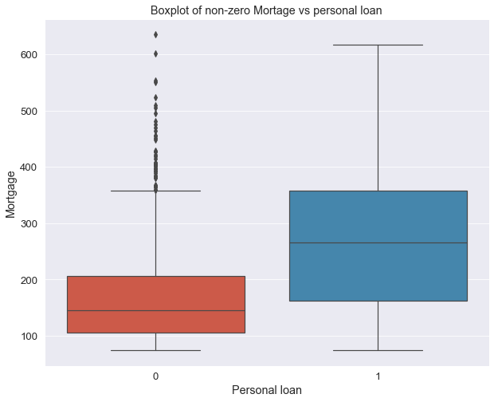
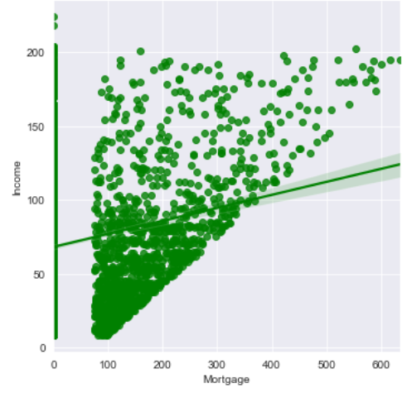
Mortgage
The median mortgage amount is relatively high among the customers who have accepted the personal loans.
This behavior may be due to the inability to pay the installments for the mortgages, especially among those who have obtained high mortgages.
The customers with higher incomes have obtained mortgages with higher values.

Slide 25
Suggestions for Advanced Analysis

Slide 26
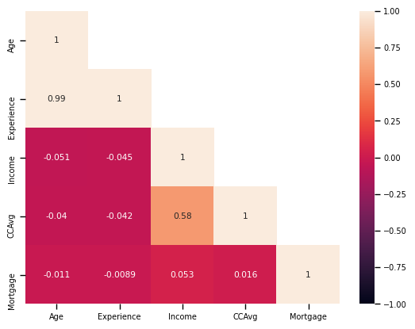
Suggestions for Advanced Analysis
Signals us about the multi collinearity in data!
Spearman rank correlation

Slide 27

Suggestions for Advanced Analysis Ctd….
IMBALANCED!!!!
We suggest to use SMOTE, Random under sampling methods since the dataset is imbalanced

Slide 28
Suggested techniques to be used for Advanced analysis
1. SMOTE, Random under sampling methods
2. Models
Tree based models
(Bagging, Random forest, XgBoost)
Support Vector Machine
KNN
Logistic Regression with Regularization methods
Ridge
Lasso
Elastic net

Slide 29
References
Marketing Ideas for Loan Companies: Better Personal Loan Advertisement. (n.d.). Retrieved June 22, 2021, from https://www.msp-pgh.com/personal-loan-marketing-ideas-for-loan-companies/
Personal Loan Statistics for 2020 | The Ascent. (n.d.). Retrieved June 23, 2021, from https://www.fool.com/the-ascent/research/personal-loan-statistics/
Personal Loans for Debt Consolidation: What’s The Average Amount? (n.d.). Retrieved June 22,2021, from https://www.cnbc.com/select/average-personal-loan-amount-for-debt-consolidation/
6 Things To Know About Personal Loans | Credit Karma. (n.d.). Retrieved June 24, 2021, from https://www.creditkarma.com/personal-loans/i/what-you-should-know-about-personal-loans
How much debt Americans have at every age. (n.d.). Retrieved June 22, 2021, from https://www.cnbc.com/2018/08/20/how-much-debt-americans-have-at-every-age.html
Grants | Federal Student Aid. (n.d.). Retrieved June 24, 2021, from https://studentaid.gov/understand-aid/types/grants
Securities Analysis: Investment Risks and the SIE - dummies. (n.d.). Retrieved June 26, 2021, from https://www.dummies.com/test-prep/securities-analysis-investment-risks-and-the-sie/
Good Reasons for Personal Loans. (n.d.). Retrieved June 26, 2021, from https://howmuch.net/articles/why-do-americans-take-out-personal-loans

Slide 30

Thank You!
THERA BANK

Slide 31
Questions?

